Slide 1
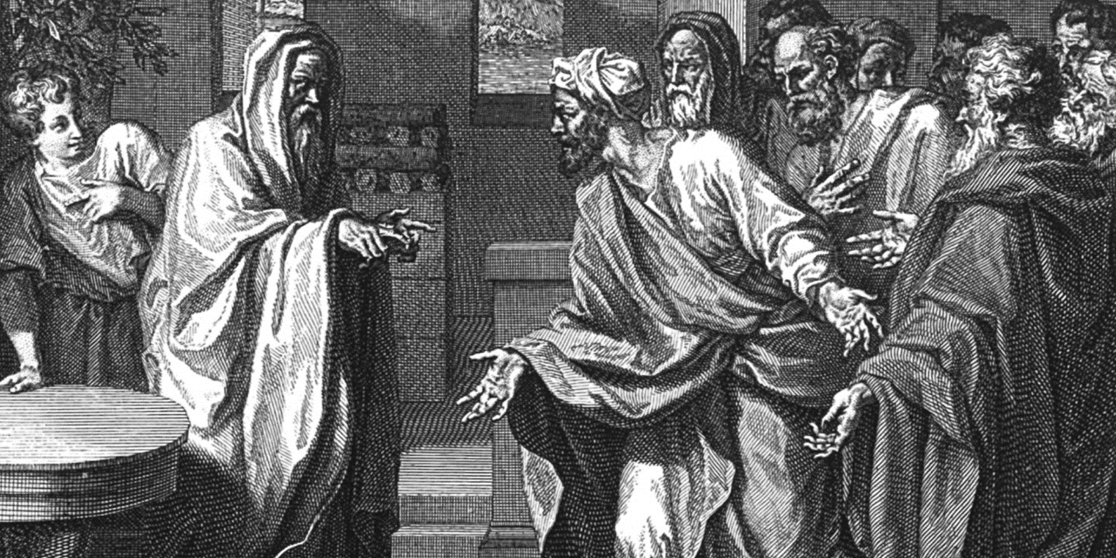

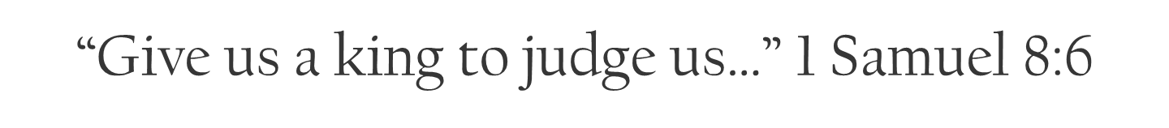

Slide 2
God’s people see potential problems and potential solutions, they want the best possible outcome for themselves. The danger is this; looking to the world for solutions vs. seeking God’s will. In seeking the best the world offers; God's people end up rejecting God's rule over their lives. Dangerous.

Slide 3
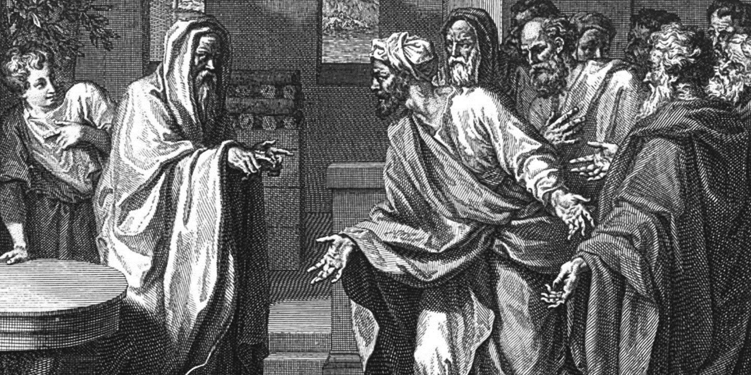
The Timeline
A great deal of time has passed.
Joel, the firstborn was also called Vashni in 1 Chron 6:28.
Notice that Sam’s son’s names reflect his faith in God.
Joel = “Jehovah is God”
Abiah = “God is father”

Slide 4

The Trouble
Samuel walked right – his sons walked not in his ways.
Satan is always at work to corrupt you and pull you away from God’s Word and ways.
Parents: believe God’s promises.

Slide 5
Proverbs 22:6 Train up a child in the way he should go: and when he is old, he will not depart from it.

Slide 6
The Trouble
Samuel walked right – his sons walked not in his ways.
Satan is always at work to corrupt you and pull you away from God’s Word and ways.
Parents: believe God’s promises.
In rebelling against their father’s ways, Samuel’s sons disqualified themselves!

Slide 7
Deuteronomy 16:18-20 Judges and officers shalt thou make thee in all thy gates, which the LORD thy God giveth thee, throughout thy tribes: and they shall judge the people with just judgment. 19 Thou shalt not wrest judgment; thou shalt not respect persons, neither take a gift: for a gift doth blind the eyes of the wise, and pervert the words of the righteous. 20 That which is altogether just shalt thou follow, that thou mayest live, and inherit the land which the LORD thy God giveth thee.

Slide 8
The Trouble
Samuel walked right – his sons walked not in his ways.
Satan is always at work to corrupt you and pull you away from God’s Word and ways.
Parents: believe God’s promises.
In rebelling against their father’s ways, Samuel’s sons disqualified themselves!
Samuel’s sons were greedy for money.

Slide 9
1 Timothy 6:10 For the love of money is the root of all evil: which while some coveted after, they have erred from the faith, and pierced themselves through with many sorrows.

Slide 10
The Trouble
Samuel walked right – his sons walked not in his ways.
In rebelling against their father’s ways, Samuel’s sons disqualified themselves!
Samuel’s sons were greedy for money.
Samuel’s sons took bribes and perverted judgment

Slide 11
Deut 16:19 Thou shalt not wrest judgment; thou shalt not respect persons, neither take a gift: for a gift doth blind the eyes of the wise, and pervert the words of the righteous.

Slide 12
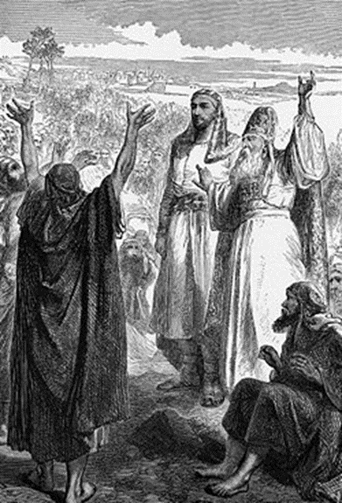
Two Key Points to Remember!
Taking money to help others get what they want in a verdict always perverts justice and discourages God’s people.
Putting spiritually unqualified or corrupt people in positions of authority will always discourage God’s people!
PROBLEM: God’s people got discouraged and went to the world’s ways for a solution.

Slide 13
The Trap
We need to listen to our elders.
  Leviticus 19:32 Thou shalt rise up before the hoary head, and honour the face of the old man, and fear thy God: I am the LORD.
  Proverbs 16:31 The hoary head is a crown of glory, if it be found in the way of righteousness.
NOTICE: Their real motive has been revealed!
They still want to live like the pagan nations around them!
God knew this demand was coming!

Slide 14
Deuteronomy 17:14-20 When thou art come unto the land which the LORD thy God giveth thee, and shalt possess it, and shalt dwell therein, and shalt say, I will set a king over me, like as all the nations that are about me; 15 Thou shalt in any wise set him king over thee, whom the LORD thy God shall choose: one from among thy brethren shalt thou set king over thee: thou mayest not set a stranger over thee, which is not thy brother. 16 But he shall not multiply horses to himself, nor cause the people to return to Egypt, to the end that he should multiply horses: forasmuch as the LORD hath said unto you, Ye shall henceforth return no more that way.

Slide 15
17 Neither shall he multiply wives to himself, that his heart turn not away: neither shall he greatly multiply to himself silver and gold. 18 And it shall be, when he sitteth upon the throne of his kingdom, that he shall write him a copy of this law in a book out of that which is before the priests the Levites: 19 And it shall be with him, and he shall read therein all the days of his life: that he may learn to fear the LORD his God, to keep all the words of this law and these statutes, to do them: 20 That his heart be not lifted up above his brethren, and that he turn not aside from the commandment, to the right hand, or to the left: to the end that he may prolong his days in his kingdom, he, and his children, in the midst of Israel.

Slide 16
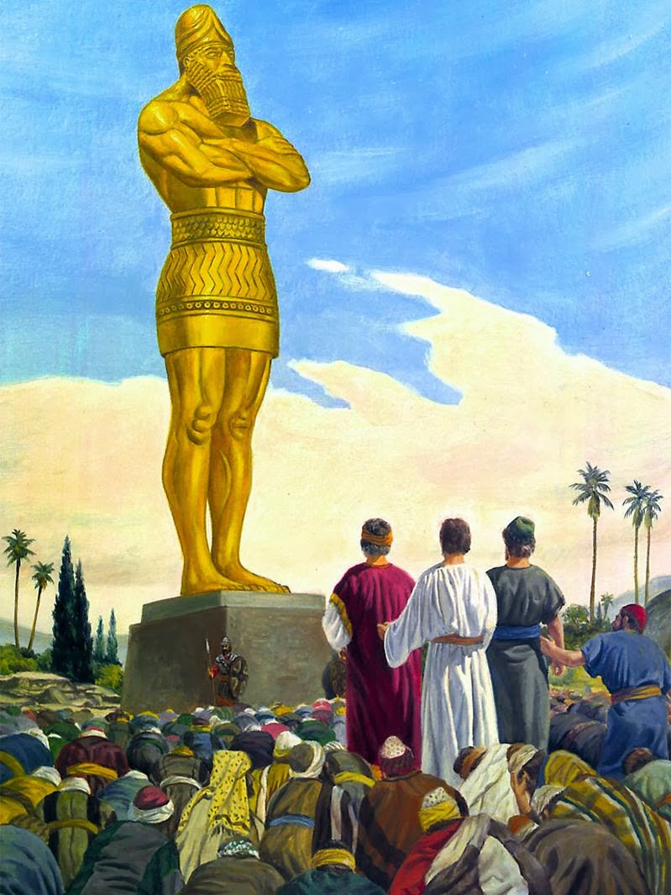
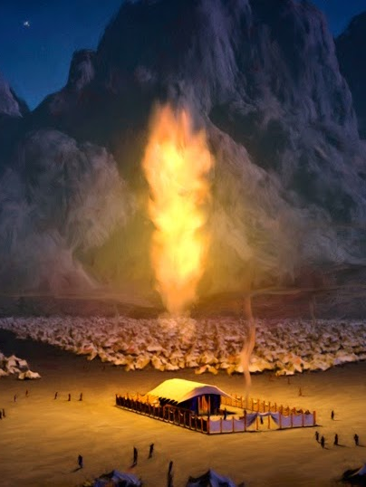
Everywhere else in the ancient world, the king was a god. In Israel, God was king.

Slide 17
Romans 12:2 And be not conformed to this world: but be ye transformed by the renewing of your mind, that ye may prove what is that good, and acceptable, and perfect, will of God.

Slide 18
1 Peter 2:9 But ye are a chosen generation, a royal priesthood, an holy nation, a peculiar people; that ye should shew forth the praises of him who hath called you out of darkness into his marvellous light:

Slide 19
Hosea 13:9-11 O Israel, thou hast destroyed thyself; but in me is thine help. 10 I will be thy king: where is any other that may save thee in all thy cities? and thy judges of whom thou saidst, Give me a king and princes? 11 I gave thee a king in mine anger, and took him away in my wrath.

Slide 20
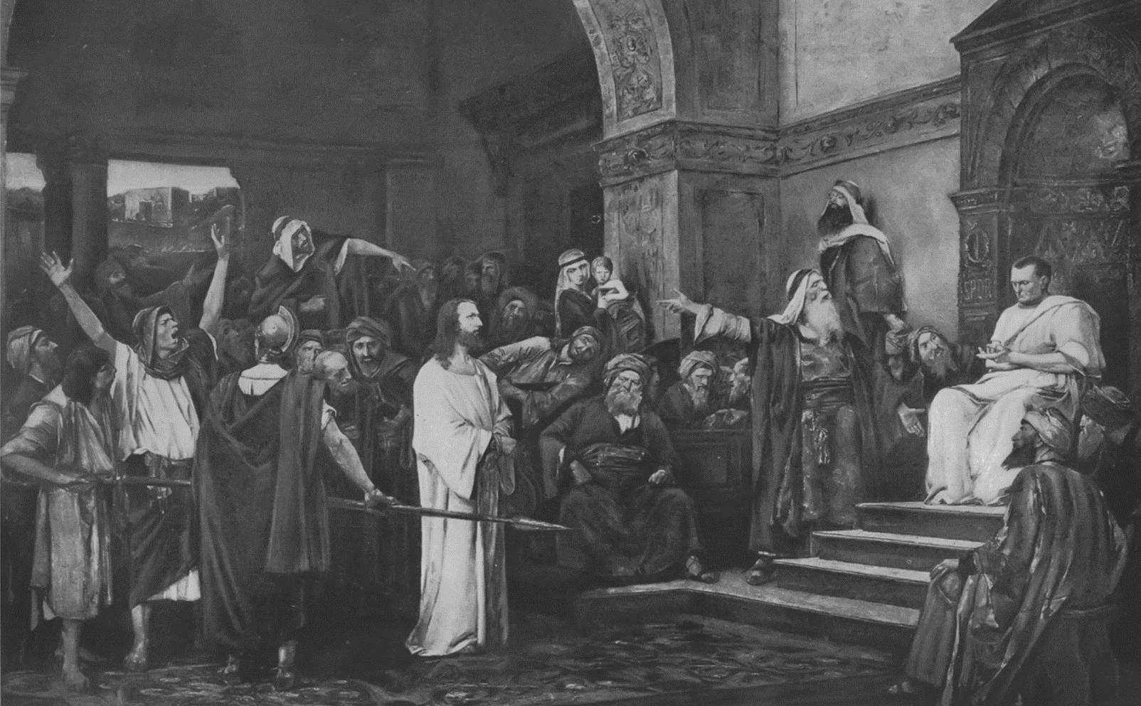
The Truth
In getting Saul, Israel rejected God. Vs 7 (Luke 19:11-14)
Instead of reacting in
the flesh, Samuel took
his complaint to the
Lord in prayer!

